Slide 1

Week #6
AI Academy®
1
Day 1:
What is Product Hunting?
Customer Criteria & Demands
Manage Product Sourcing
Reviews & Feedbacks

Slide 2
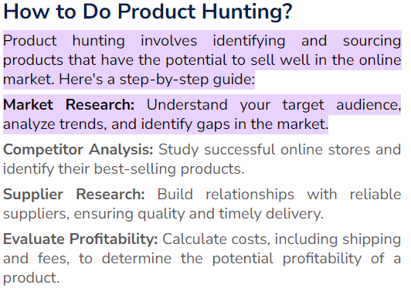
Week #6
AI Academy®
1

Slide 3
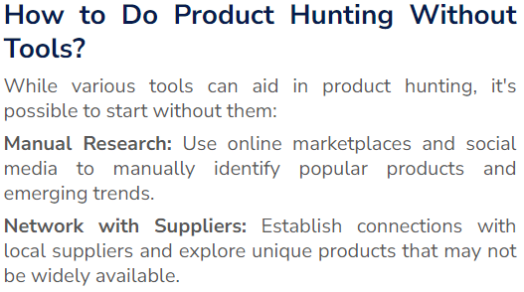
Week #6
AI Academy®
1

Slide 4

Week #6
AI Academy®
Best tools for Product hunting:
1

Slide 5
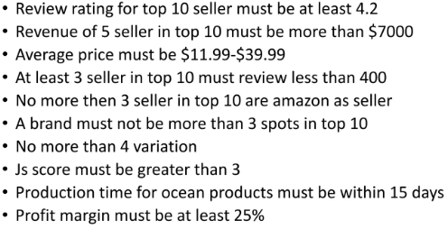
Week #6
AI Academy®
1

Slide 6
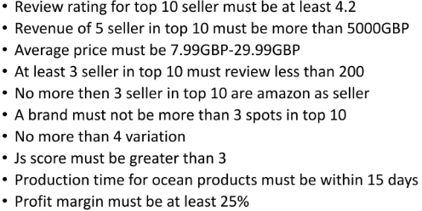
Week #6
AI Academy®
1

Slide 7
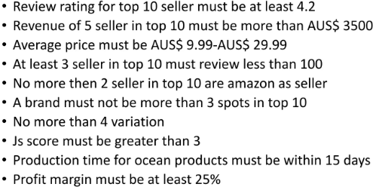
Week #6
AI Academy®
1

Slide 8
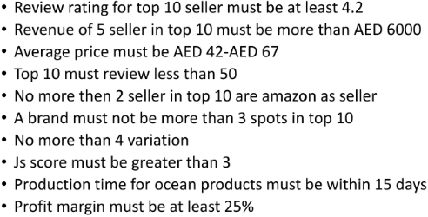
Week #6
AI Academy®
1

Slide 9
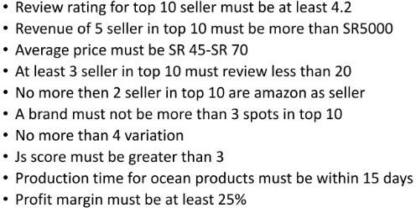
Week #6
AI Academy®
1

Slide 10
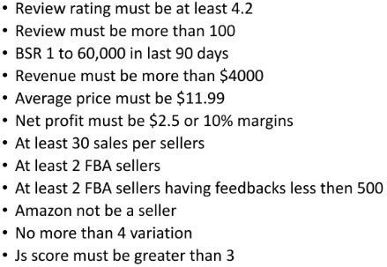
Week #6
AI Academy®
1

Slide 11
Week #6
AI Academy®
2
Day 2:
Different Strategies & Techniques for Local & Global Market Research
Various Criteria and Tools
Reviews & Feedbacks

Slide 12
Week #6
AI Academy®
3
Day 3:
Identify or Define Criteria Evaluation
Set Viability for Products
Set Profitability for Product
Reviews & Feedbacks

Slide 13
Week #6
AI Academy®
4
Day 4:
Defining & Selecting Profitable Suppliers
Local & Global
Winning Products Criteria
Reviews & Feedbacks

Slide 14
Week #6
AI Academy®
5
Day 5:
Testing Product
Validating Product
Before launch
Reviews & Feedbacks

